Slide 1
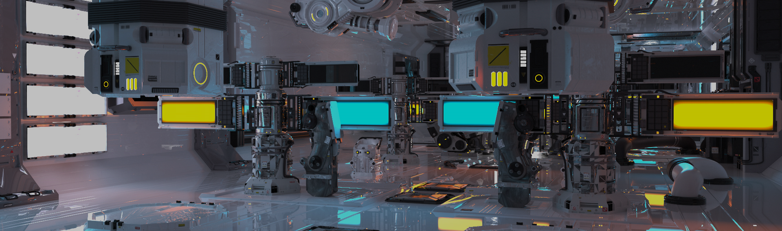
GPU Shader 3
電腦圖學導論實習
Information Technology Innovation | NTUST

Slide 2
Overview
Shading
Cubemap
Skybox
Reflect
Refract
Homework
Notes:
提醒
本周check point1
有些項目不在作業中 要記得做

Slide 3
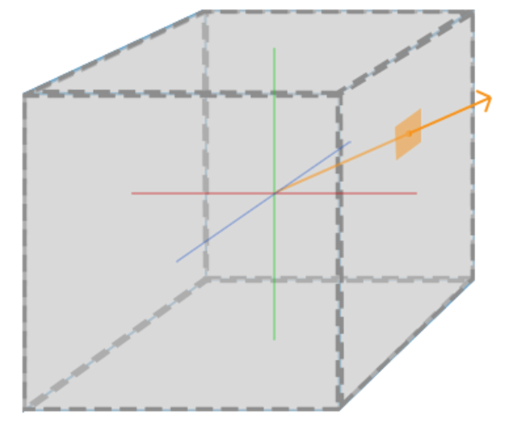
Cubemap
Once a direction is provided, OpenGL will fetch the corresponding texture pixel that the direction vector intersects with, returning the correct texture sampling value.

Slide 4
Cubemap Gen&Bind
GLuint textureID;
glGenTextures(1, &textureID) ;
glBindTexture(GL_TEXTURE_CUBE_MAP, textureID);

Slide 5
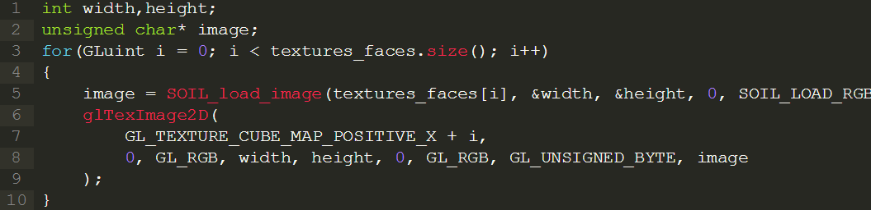
Cubemap set Texture
OpenGL define | Equal to | Orientation
GL_TEXTURE_CUBE_MAP_POSITIVE_X | GL_TEXTURE_CUBE_MAP_POSITIVE_X + 0 | Right
GL_TEXTURE_CUBE_MAP_NEGATIVE_X | GL_TEXTURE_CUBE_MAP_POSITIVE_X + 1 | Left
GL_TEXTURE_CUBE_MAP_POSITIVE_Y | GL_TEXTURE_CUBE_MAP_POSITIVE_X + 2 | Top
GL_TEXTURE_CUBE_MAP_NEGATIVE_Y | GL_TEXTURE_CUBE_MAP_POSITIVE_X + 3 | Bottom
GL_TEXTURE_CUBE_MAP_POSITIVE_Z | GL_TEXTURE_CUBE_MAP_POSITIVE_X + 4 | Back
GL_TEXTURE_CUBE_MAP_NEGATIVE_Z | GL_TEXTURE_CUBE_MAP_POSITIVE_X + 5 | Front
Notes:
Opencv / stb_image

Slide 6
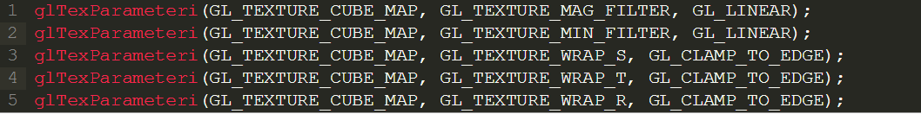
Cubemap set Parameter
Set texture filter & texture wrap

Slide 7
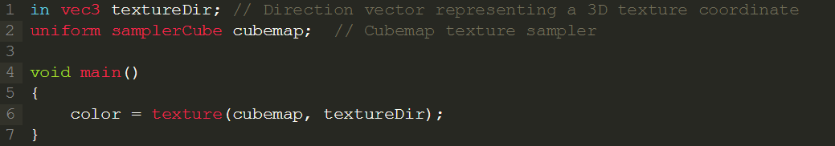
Fragment shader example

Slide 8
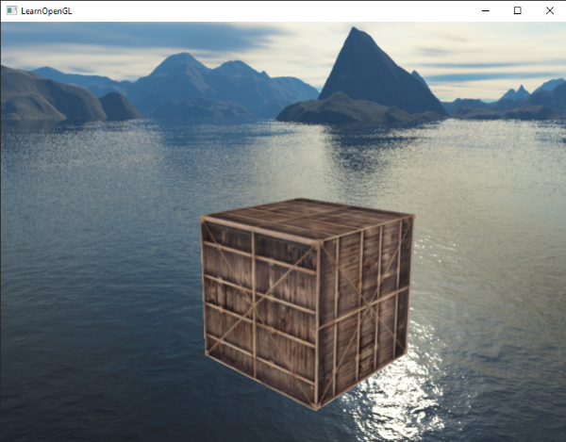
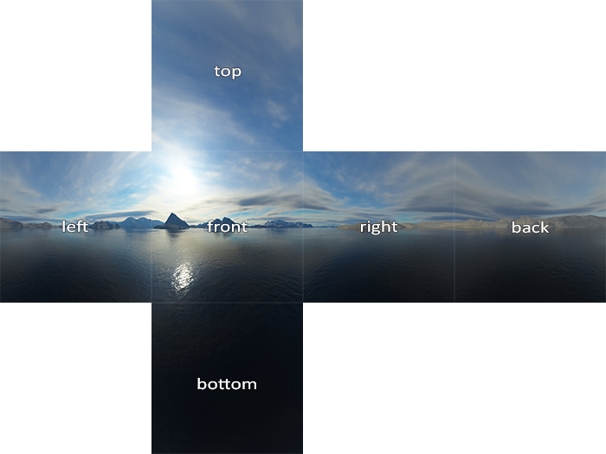
Skybox
https://learnopengl.com/Advanced-OpenGL/Cubemaps

Slide 9
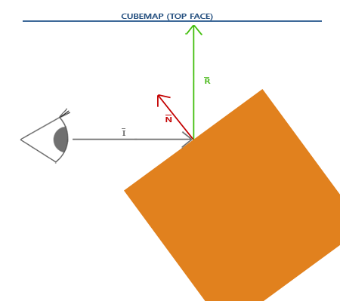
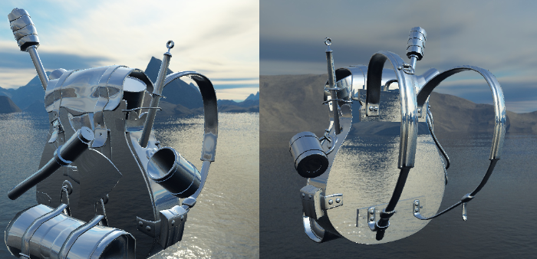
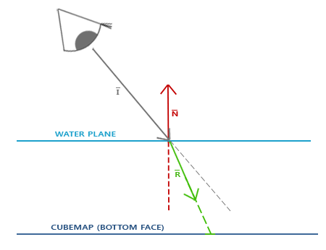
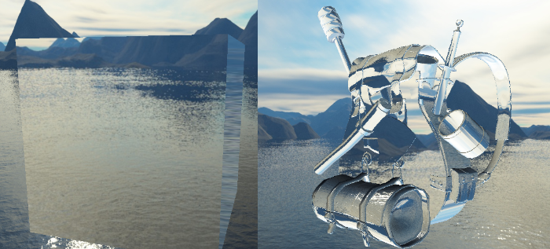
Reflect、Refract using skybox
Reflect
Refract

Slide 10
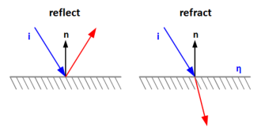
Reflect
The eye sees the specularly reflected scene.
Render the reflected scene on the surface.
vec3 reflect(I, N) get the reflected vector
I : vector from camera to geometry position
N : geometry Normal

Slide 11
Refract
In physics, refraction is the redirection of a wave as it passes from one medium to another.
Render the refracted scene on the surface.
vec3 refract(I, N, eta) get the refracted vector
I : vector from camera to geometry position
N : geometry Normal
eta : Specifies the ratio of indices of refraction

Slide 12
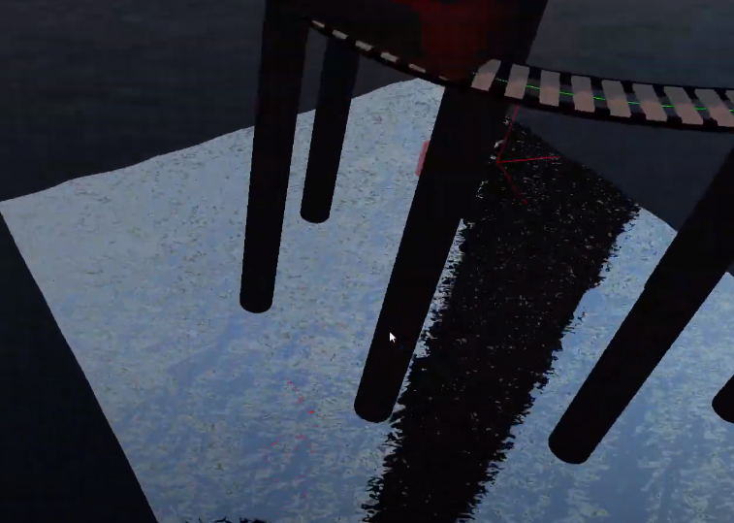
Advance
Multi-pass rendering
Dynamic environment maps
For closed convex object
https://youtu.be/Q-7MElJ88dk
Real-time generate skybox
Frame buffer object
OpenGL Water Tutorials
Reflect texture
Refract texture

Slide 13
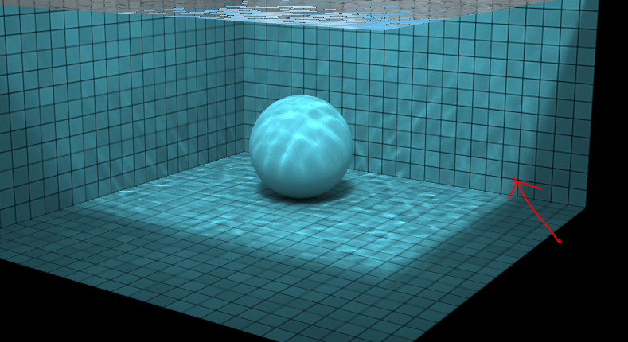
Caustics
Reference：http://madebyevan.com/webgl-water/

Slide 14
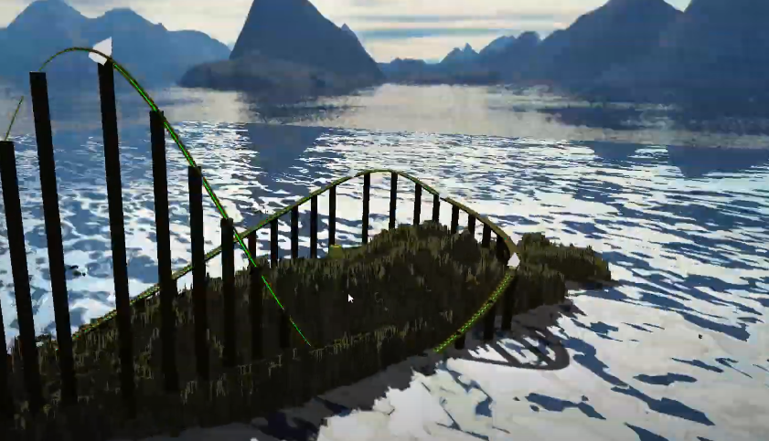
Hw11
Shading wave with shader
Cubemap
Skybox
Reflect
Refract

